Slide 1
Lesson 8 – Website Enumeration
BYU CTF Group

Slide 2
Website Enumeration
Figuring out what pages exist on a website
Many different methods
Robots.txt
Website crawling
Dirb/DirBuster

Slide 3
Robots.txt
Search engine crawlers visit websites and index them for their engine
To reduce traffic from these crawlers, web admins create robots.txt pages to tell which bots they want to go where
This can’t be enforced – you only ask nicely
Malicious crawlers can be programmed to go to these pages specifically to figure out your dirty little secrets

Slide 4
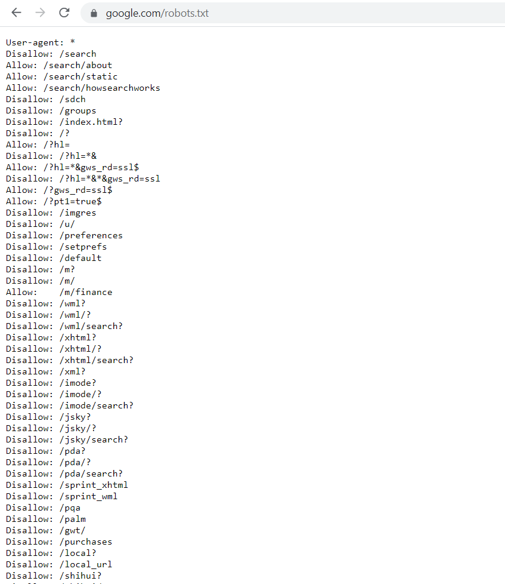
Example robots.txt

Slide 5
CTFLearn robots.txt
Can you find the flag? (https://ctflearn.com/robots.txt)

Slide 6
Website Crawling
A crawler/bot/spider reads and copies the contents of every page on a website
Goes to a page, copies it, extracts links to all the other pages, and then visits those pages and repeats the process
Automates the process so that you can browse a website's files for interesting/suspicious files
Easy for websites to know if you're crawling them - they request tons of pages at an inhuman speed
In some web crawlers, there are options you can specify to throttle the requests and make you seem more legitimate (more like a real person), including spacing out requests, adding in user agents, etc.
Some advanced ones will even spoof their IP address using various methods so it looks like the traffic is coming from different sources.

Slide 7
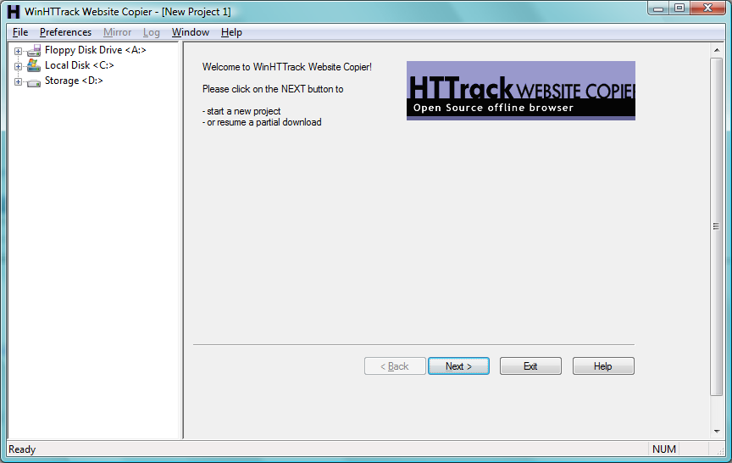
HTTrack
Open source
Easy to use
Graphical and CLI
Windows and Linux
Customizable

Slide 8
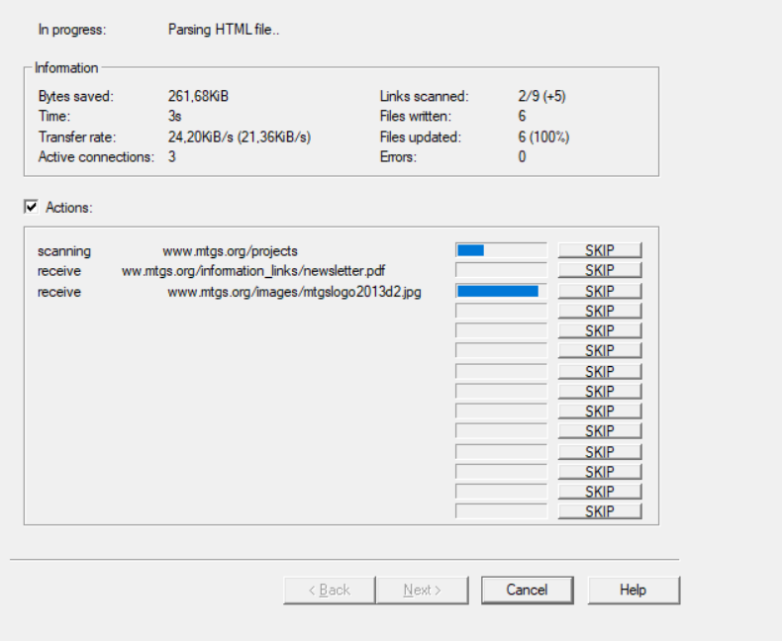
HTTrack Progress

Slide 9
Scraping vs. Crawling
Crawling | Scraping
Entire website | Subset of a website
Copies/downloads | Can copy, download, or extract data from it
Used for archiving/indexing | Used for monitoring, extracting data, etc.

Slide 10
Example Website
http://books.toscrape.com/

Slide 11
Dirb/DirBuster
These tools enumerate website pages and directories through brute force or dictionaries
Dirb is a CLI tool used in Linux
DirBuster is a GUI application written in Java

Slide 12
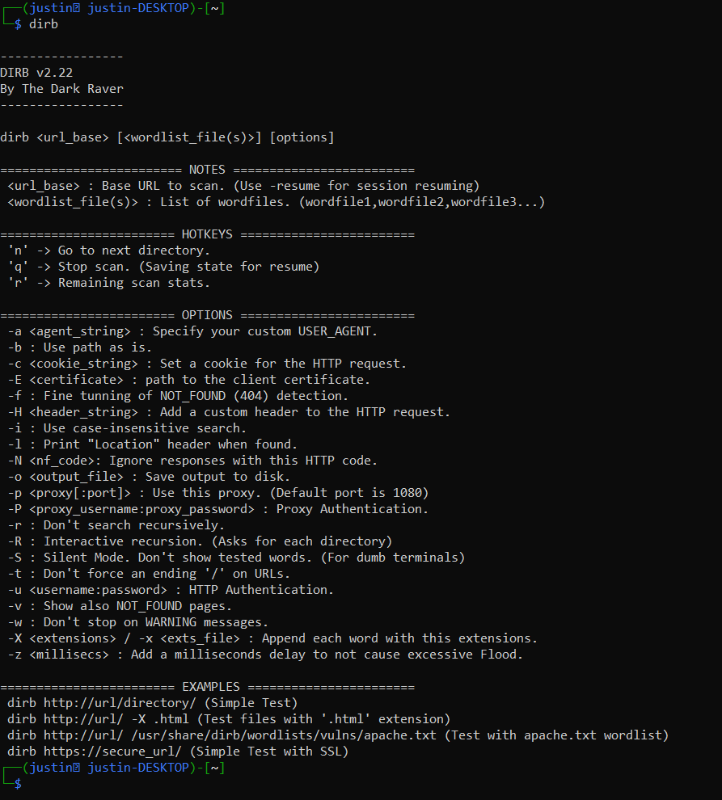
Dirb Helper

Slide 13
Dirb Example
Try running dirb on my personal website https://justinapplegate.me
Note – it’s easy for me to discover this because you’re sending thousands of HTTP requests to non-existent pages per minute
Automatically restarts the search in any directories it finds

Slide 14
Authentication
Obfuscation (hiding things) isn’t security – please use authentication if you have any sensitive information on your website
There are other methods of finding “hidden” webpages, including perusing search history and logging Referrer headers on HTTP requests

